Slide 1

Turning 6 Rows into Actionable Insights:
Workforce Analytics at LongDistanceTelecoms
By DUMISANI MAXWELL MUKUCHURA,
dumisanimukuchura@gmail.com
Analytics Highlights.
Visualized Findings.
Recommendations.

Slide 2
Optimizing Field Operations at LongDistanceTelecoms
Analytics Highlights.
Avg. Customer Satisfaction: 3.75 / 5
Education Impact: BSc technicians had higher satisfaction (4.0/5) than Diploma holders (3.5/5)
Correlation Found: Technicians with more experience tend to resolve more faults i.e Years of Experience ↔ Faults Resolved (r = 0.50)
Age Comparison: Technicians <30 Years had higher satisfaction (4.3/5 vs 3.2/5 of Technicians >=30 Years)
Gender Insights:
-Males accounted for 100% escalated issues vs. 0% for Females.
-Females had higher satisfaction (4.5/5 vs Male 3.0/5) but lower task completion (2.67 vs Male 5.0 tasks)
This is a demonstration of analytical thought process on a very small dataset. Any derived insights would require a significantly larger and more representative dataset for validation in a real-world scenario.

Slide 3
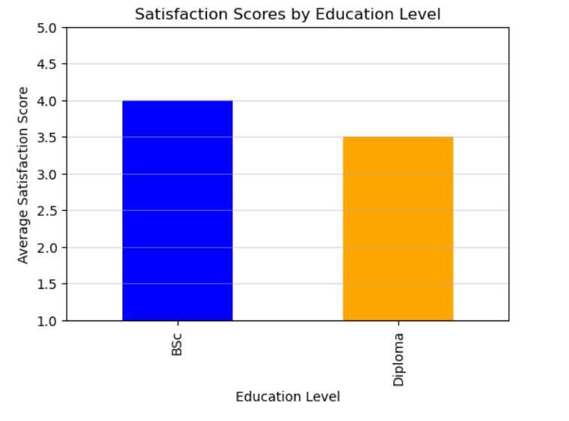
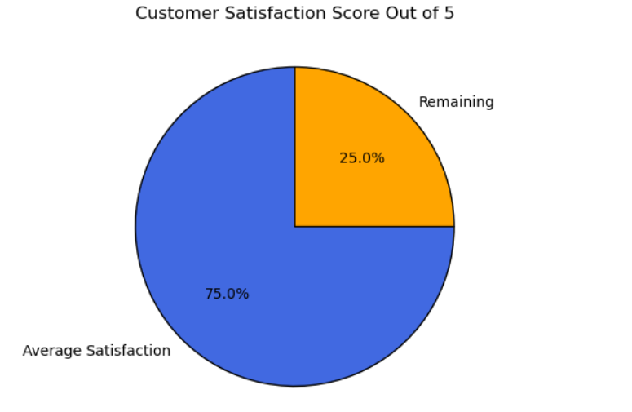
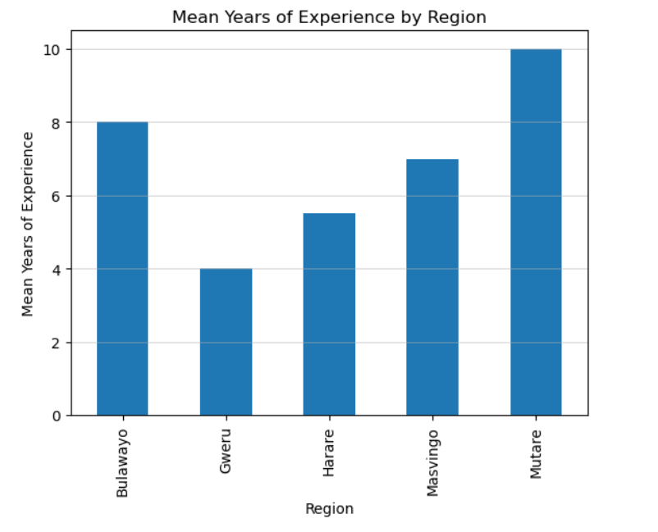
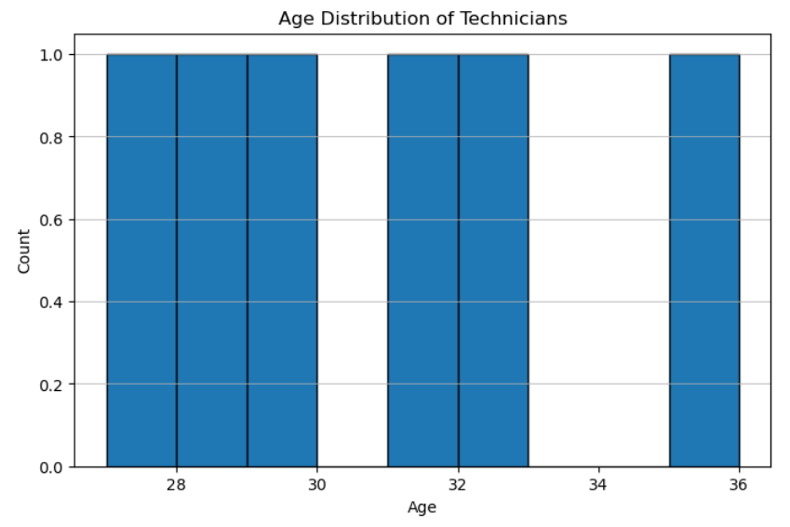
Optimizing Field Operations at LongDistanceTelecoms
Visualized Findings

Slide 4
Optimizing Field Operations at LongDistanceTelecoms
Recommendations
Considering: Top two demographic factors influencing customer satisfaction:
1. Region (categorical, impact: 1.00)
2. Years, Experience (numeric, impact: 0.99)
Productivity Improvement Recommendations (Based on Actionable Demographics):
1. Replicate Success from Gweru.
Highest satisfaction & efficiency. Document & transfer their best practices.
2. Mentorship from Mid-Tier Experience Group (3–5 yrs).
High productivity & satisfaction. Let them mentor junior staff.
3. Targeted Upskilling for Diploma Holders.
BSc holders outperform in satisfaction & efficiency. Design training to close this gap.
This is a demonstration of analytical thought process on a very small dataset. Any derived insights would require a significantly larger and more representative dataset for validation in a real-world scenario.

Slide 5
Thank You,
A presentation by DUMISANI MAXWELL MUKUCHURA,
dumisanimukuchura@gmail.com

